Slide 1


AI Powered Healthcare Robotics: Enhancing Patient Care with Advanced Technology
HARIKA YENUGA
MASTERS IN BUSINESS ANALYTICS
NORTHWOOD UNIVERSITY

Slide 2
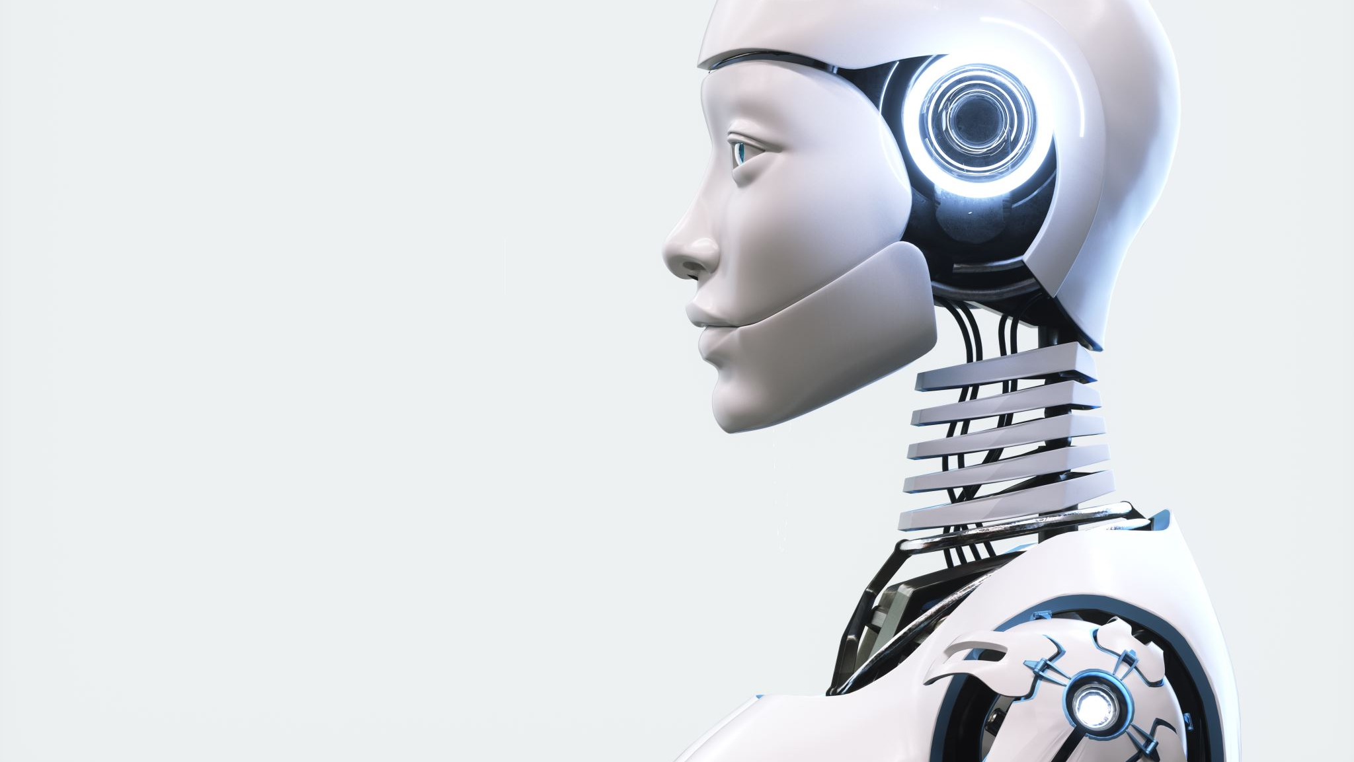
Introduction
Overview:
This project explores the transformative potential of AI-powered healthcare robotics in enhancing patient care through advanced technologies, discussing various robotic applications that improve healthcare efficiency and accuracy.
Objective:
The objective is to examine how AI-enabled healthcare robots can reduce human error, provide individualized care, and support healthcare workers by handling routine tasks, ultimately improving patient outcomes and the overall efficiency of healthcare delivery.

Slide 3
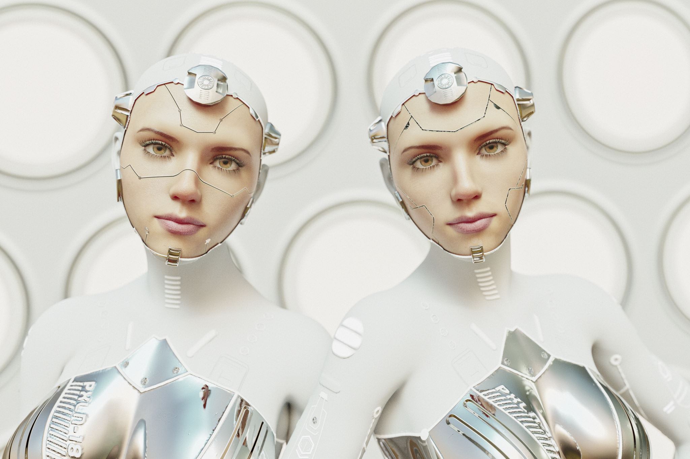
AI powered Robotics in healthcare?
Definition:
AI-powered robotics in healthcare involves the integration of artificial intelligence with robotic systems to enhance medical practices, patient care, and operational efficiency.

Slide 4
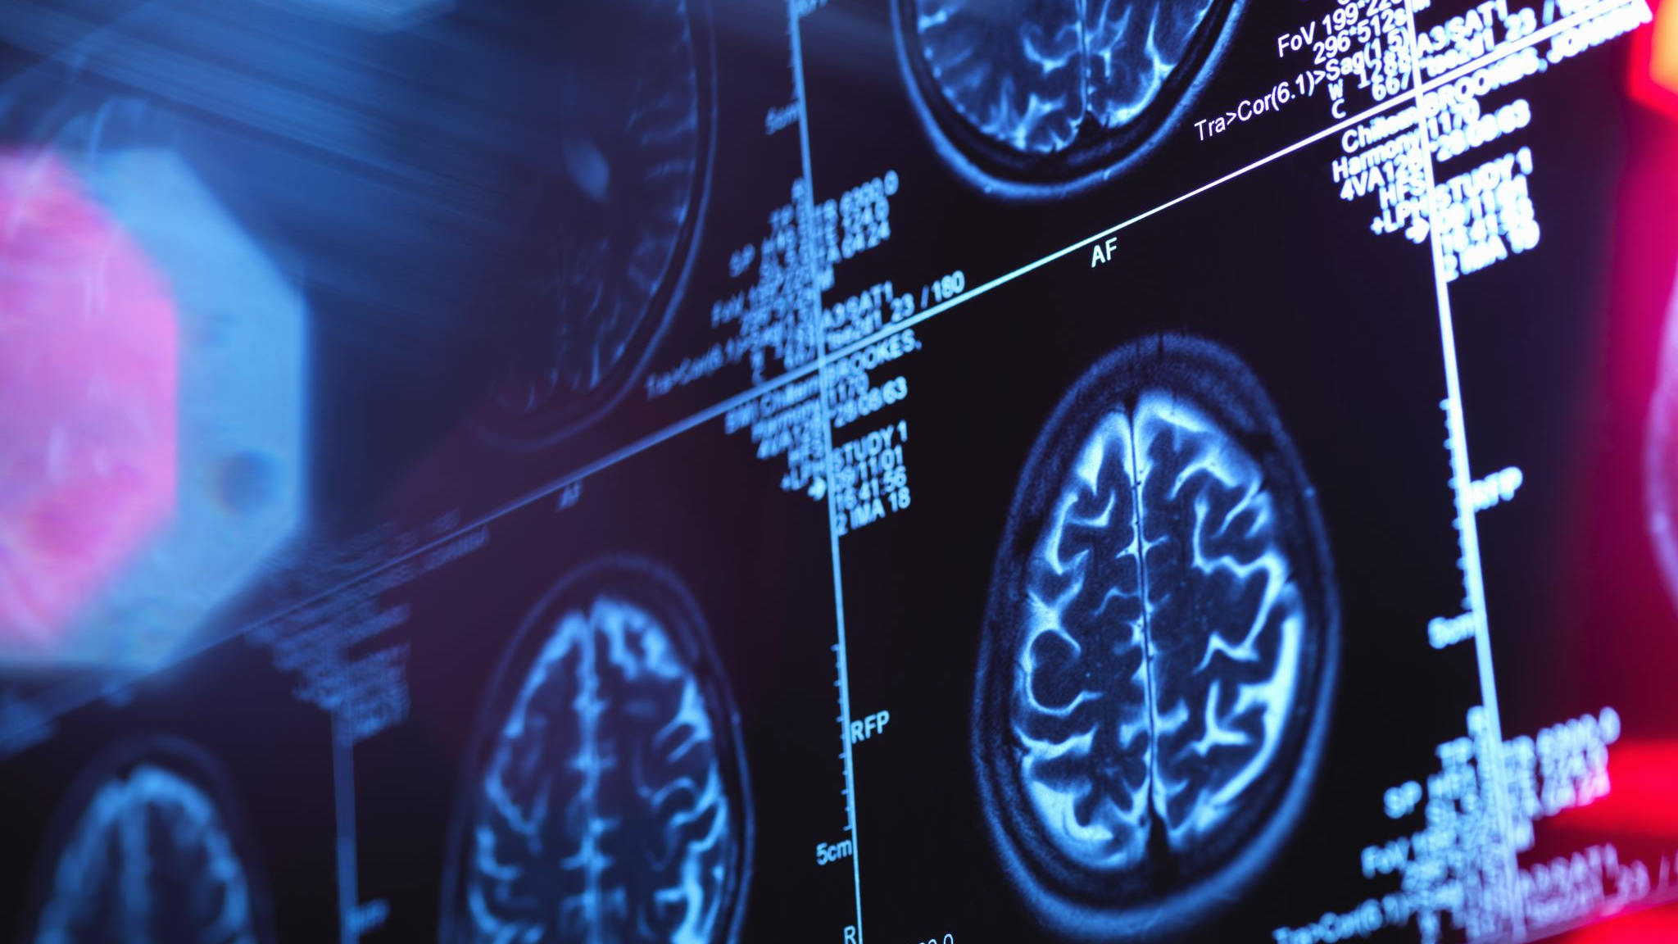
Few Applications of Healthcare AI robotics
Surgical Robots:
Function: Assist surgeons with precision and minimally invasive procedures.
Examples: Da Vinci Surgical System for complex surgeries.
Robotic Assistants:
Function: Support healthcare providers in tasks like patient monitoring, medication delivery, and logistics.
Examples: Robotic exoskeletons for physical rehabilitation.
Diagnostic AI Systems:
Function: Analyze medical images (e.g., X-rays, MRIs) and patient data to assist in diagnosis.
Examples: AI algorithms for early detection of diseases like cancer.

Slide 5


TYPES OF ROBOTS IN HEALTHCARE

Slide 6
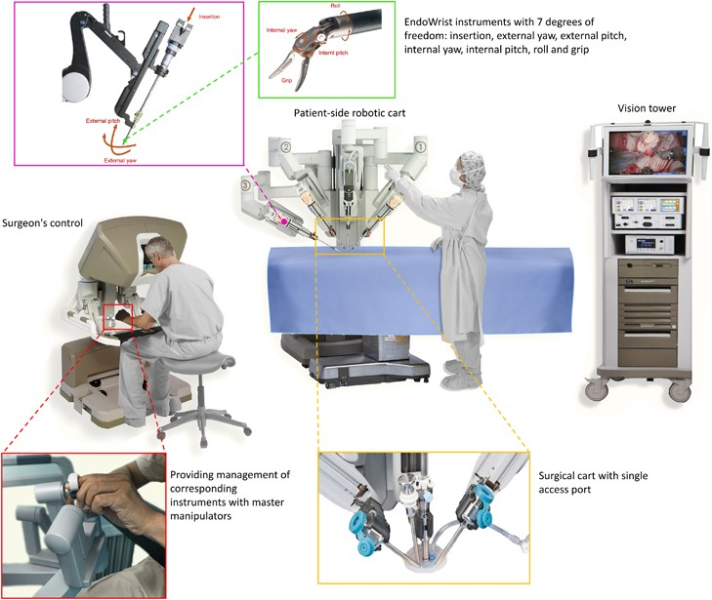
Surgical Assistance Robots
Definition:
Robots designed to assist surgeons in performing
precise and minimally invasive surgeries.
Examples:
Da Vinci Surgical System
Enables surgeons to operate with enhanced precision
and control through robotic arms and high-definition imaging.
Used in various procedures such as prostatectomies and cardiac
surgeries.
Benefits include reduced recovery times and
less post-operative pain for patients.
Advantages:
Enhances surgeon's capabilities, allowing for more
complex procedures with smaller incisions.
Reduces the risk of human error and improves
patient outcomes.
the da Vinci surgical system

Slide 7
MODULAR ROBOTS
Therapeutic Exoskeleton Robots
Definition:
Robots designed to assist in physical rehabilitation for patients with mobility impairments.
Functionality:
Monitors patient movements and provides support during exercises.
Tracks progress and adjusts rehabilitation plans based on real-time data.
Examples:
Ekso Bionics Provides powered exoskeletons for rehabilitation of patients with spinal cord injuries and stroke.
Helps patients regain mobility and independence through targeted physical therapy.
Benefits:
Improves patient strength and mobility.
Enables personalized rehabilitation plans tailored to individual patient needs.

Slide 8
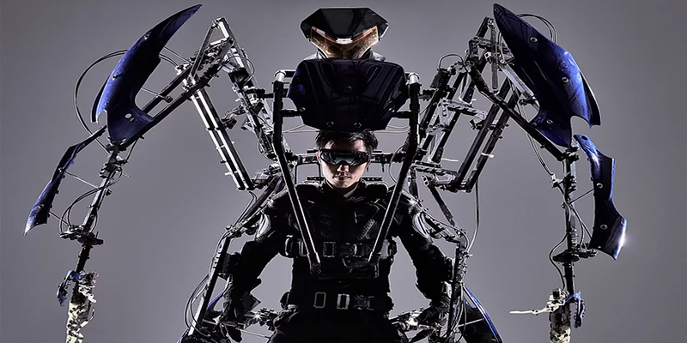
Iron Man might be part of the fictional Marvel Universe, but the suit? Yep, that tech really exists.
Skeletonics: Skeletonics Arrive
Want to be bigger than life? Skeletronics will supersize you to nearly 10 feet tall and enable you to walk through a crowd of people like a proverbial giant. With a fusion of mechanics and electronics, the fingers are able to move with precision, as well as the legs. Kinetic energy moves Skeletonics instead of a battery or electricity.
The Skelectonic exoskeleton supersizes its user to 10 feet tall and is fully powered by kinetic energy. | Image: Skeletonics

Slide 9
TYPES OF ROBOTS IN HEALTHCARE
Service Robots in Healthcare
Service robots play a crucial role in modern healthcare settings by improving operational efficiency, enhancing patient care, and providing valuable support to healthcare professionals. Continued advancements in robotics and artificial intelligence will further expand their capabilities and integration into healthcare practices.
Roles:
Vital Signs Monitoring:
Example: SPOT
Capable of continuous patient monitoring.
Provides real-time data on vital signs such as heart rate, blood pressure, and temperature.
Alerts healthcare teams to any deviations from normal parameters, ensuring timely interventions.
Medication Delivery:
Examples: Tug and Moxi
Tug: Self-driving robot that transports medications and supplies throughout hospitals.
Moxi: AI-supported robotic assistant equipped with a robotic arm for simple tasks like picking up and delivering items.
Reduces wait times for medications and frees up healthcare staff for patient care duties.
Emotional Support:
Example: PARO
Designed as a therapeutic robot seal to provide companionship and emotional support to patients, particularly the elderly and those with cognitive impairments.
Interacts with patients through responsive behaviors, such as moving its head and making sounds, to enhance patient morale and well-being.

Slide 10
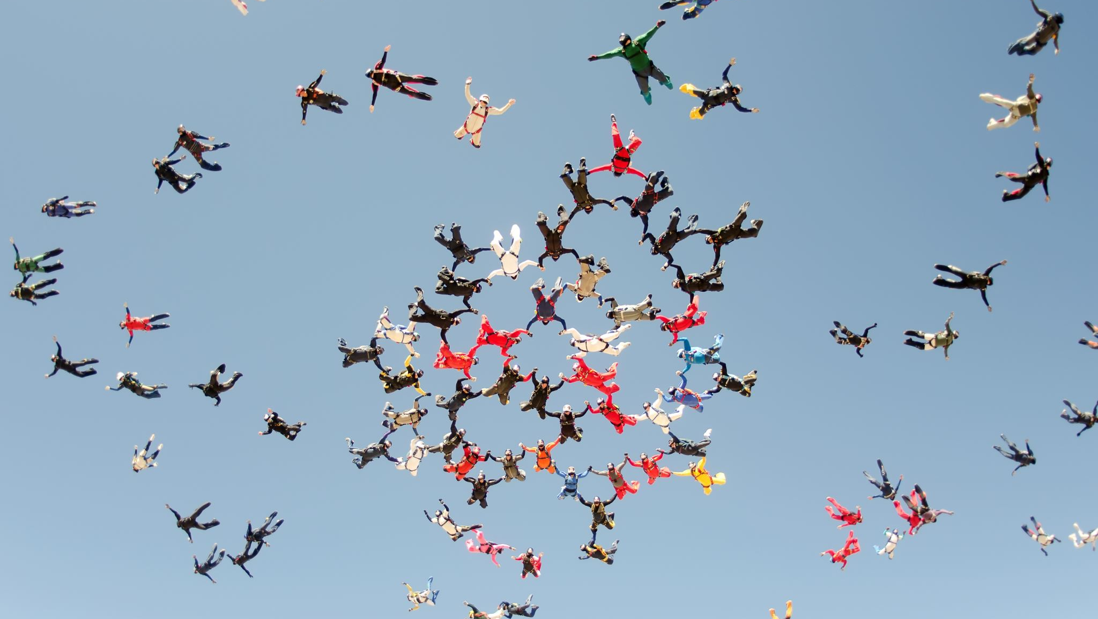
Benefits:
Reduces Workload on Healthcare Staff:
Allows healthcare professionals to focus more on direct patient care and complex medical tasks.
Improves efficiency in healthcare delivery by automating routine and repetitive tasks.
Enhances Patient Experience:
Provides timely and accurate service delivery, including prompt medication administration and continuous monitoring.
Supports emotional well-being by offering companionship and cognitive engagement, particularly in long-term care settings.

Slide 11

AI-Powered Diagnostic Systems
Definition:
Systems that use artificial intelligence to analyze medical data and assist in diagnosis and treatment planning.
Functionality:
Image Recognition: AI algorithms analyze medical images (e.g., X-rays, MRIs) to detect abnormalities and assist radiologists in diagnosis.
Natural Language Processing (NLP): AI interprets clinical notes and patient records to extract valuable insights for healthcare providers.
Examples:
IBM Watson Health
Uses AI to assist oncologists in treatment planning by analyzing vast amounts of medical literature and patient data.
Provides personalized treatment recommendations based on individual patient profiles.
Benefits:
Accelerates diagnosis and treatment, leading to improved patient outcomes.
Facilitates evidence-based medicine by integrating AI insights into clinical decision-making processes.

Slide 12

AI-Driven Patient Monitoring
Continuous Monitoring:
Function: AI monitors patient vital signs in real-time for early detection of abnormalities.
Example: Wearable devices integrated with AI for remote patient monitoring. (Apple watch 6, Fitbit Sense, Google Verily Study Watch)
Patient Management Systems:
Function: AI systems manage patient data, appointments, and treatment schedules efficiently.
Example: Chatbot-assisted patient scheduling and medication reminders.

Slide 13

Benefits: Precision and Accuracy: Reduce human error in surgical procedures and diagnostics.
Efficiency: Streamline healthcare workflows, allowing for faster and more accurate patient care.
Accessibility: Extend specialized medical expertise to remote or underserved areas.
Challenges and Considerations: Regulatory Compliance:
Ensure compliance with medical device regulations and patient safety standards.
Ethical Concerns:
Address issues related to privacy, data security, and the ethical use of AI in healthcare.
Integration and Adoption:
Overcome barriers to adoption, including cost, training, and acceptance by healthcare professionals.

Slide 14

Considerations and challenges
Ethical
Patient Privacy
Data security
Job displacement
Cost implications
Reliability and Maintenance
Initial Investment and lifetime savings.
Regulatory and legal considerations
Compliance
Approval Processes

Slide 15


Conclusion
AI-powered robots are transforming healthcare by automating tasks and personalizing treatments, which improves patient care. While these innovations are exciting, we need to address concerns about protecting patient data and ensuring that AI decisions are fair. Meeting regulatory requirements, like FDA approvals, is also important. Going forward, it's crucial for healthcare providers, regulators, and tech developers to work together. This collaboration will help us use AI safely and ethically, ensuring it benefits patients while maintaining high standards of care.

Slide 16
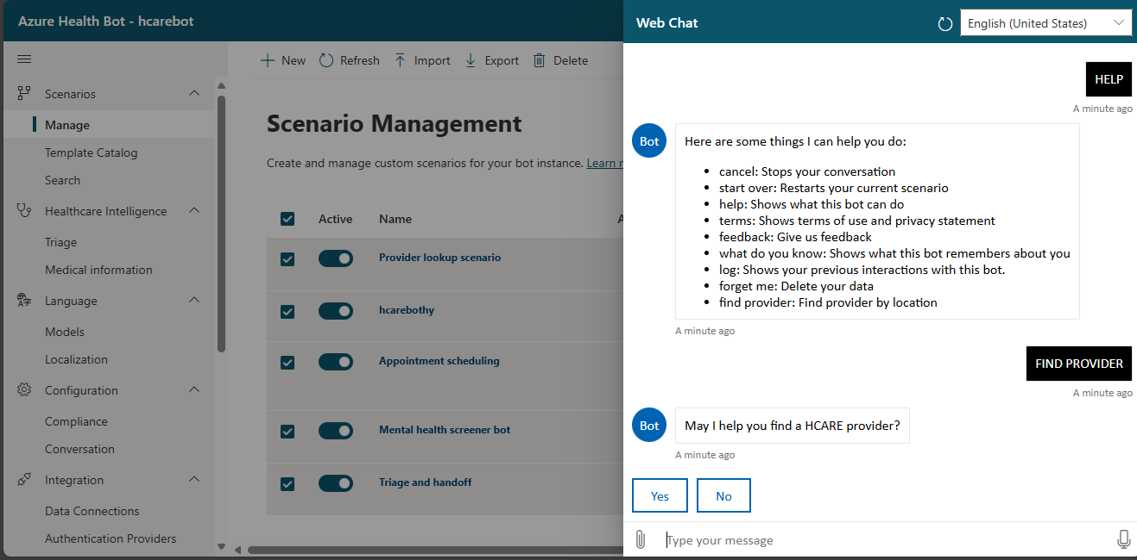
MY AI AND MY BOT WHAT MY BOT CAN DO?

Slide 17
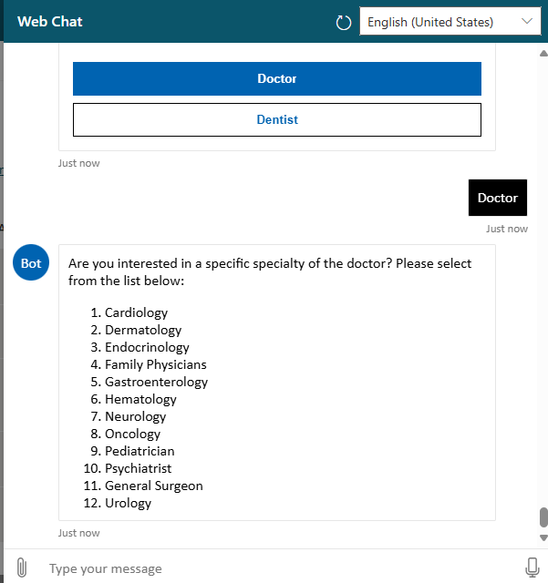

Slide 18
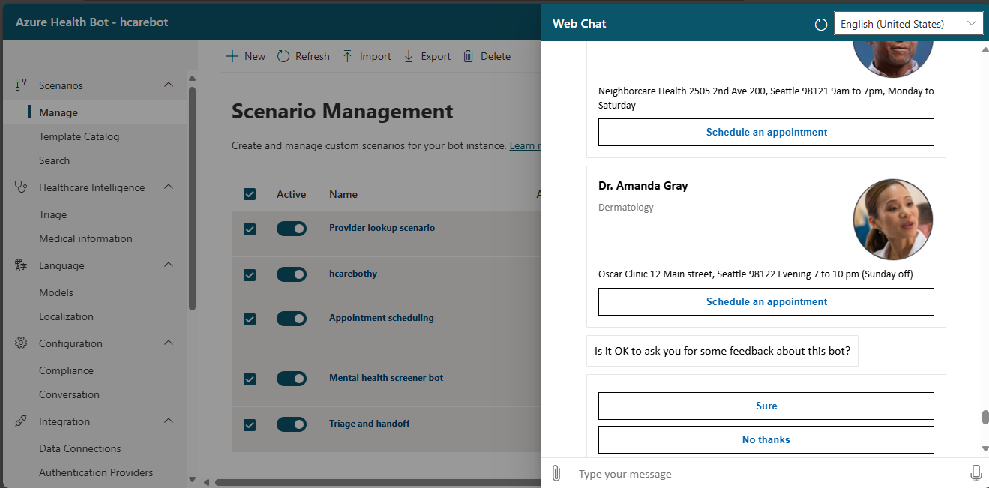
Provided me the details of the doctors i requested for

Slide 19
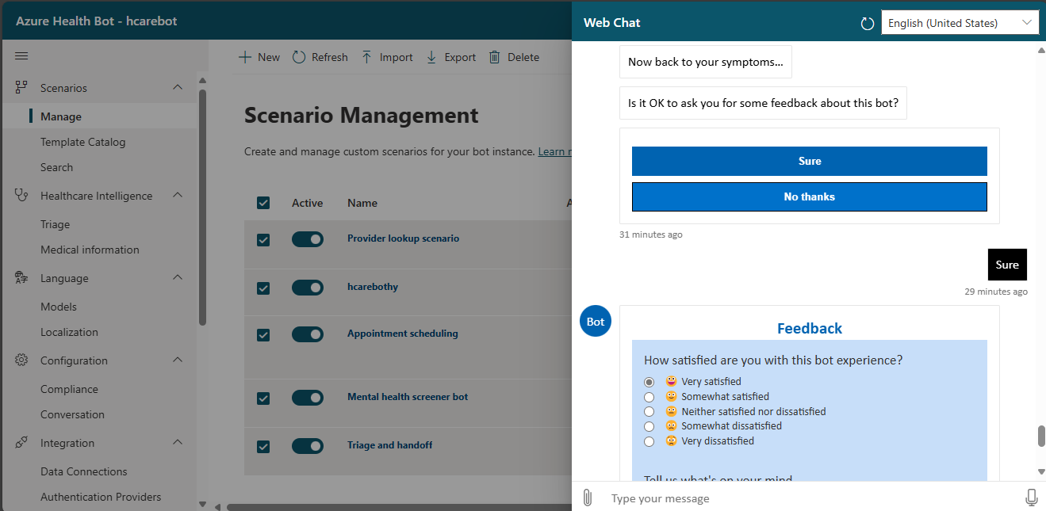

Slide 20
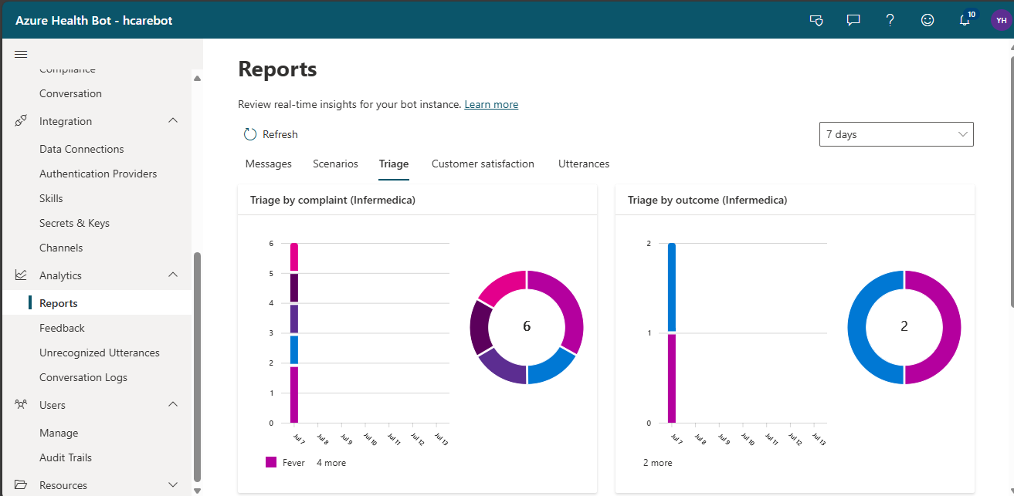
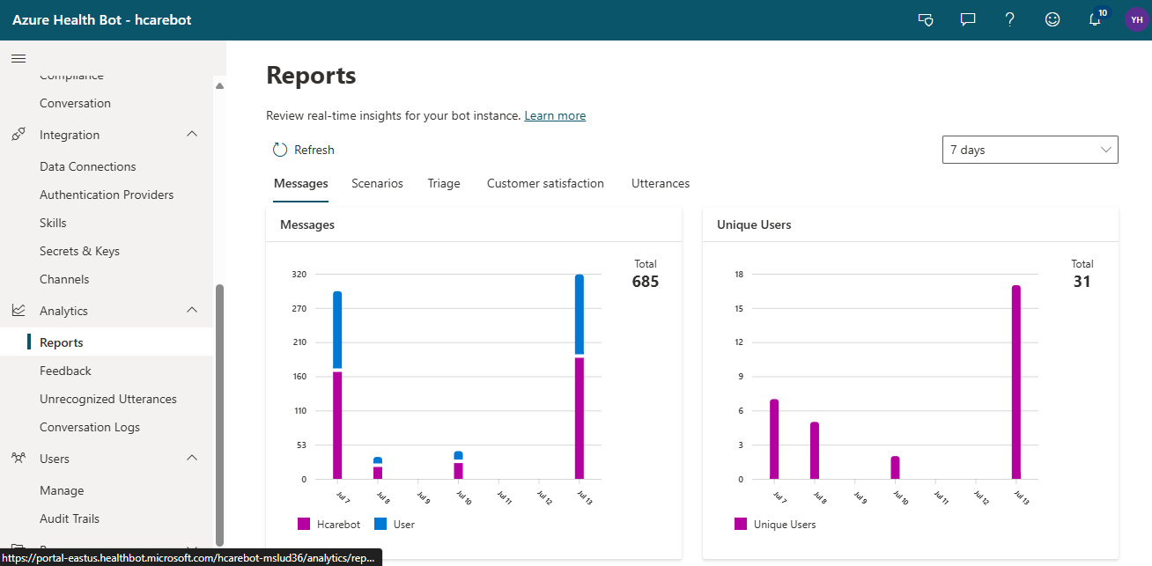
REPORT ANALYTICS

Slide 21
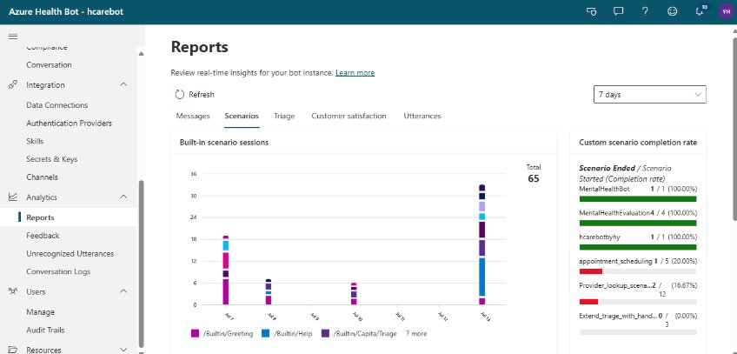

Slide 23
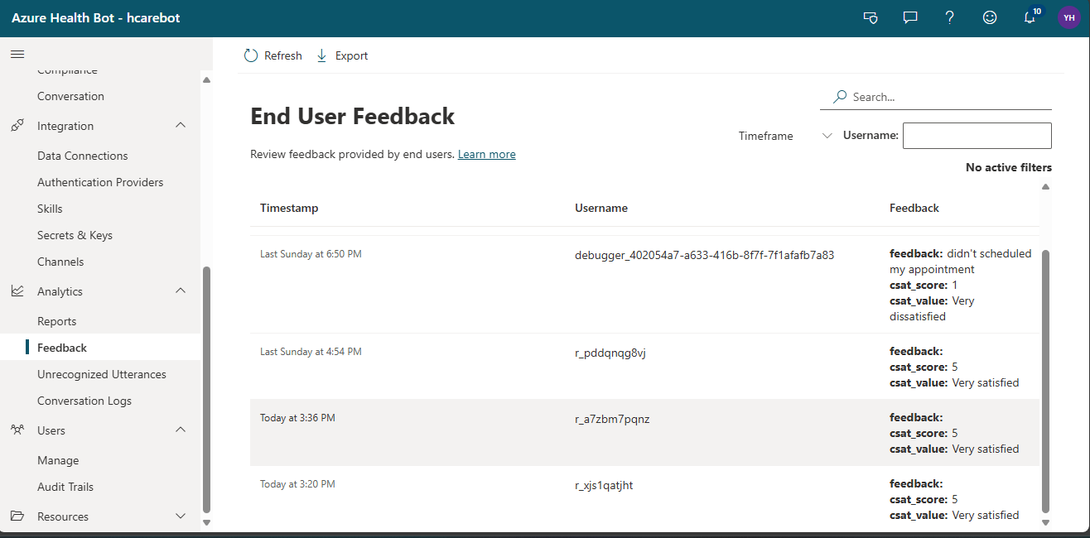

Slide 24

Q&A: Questions and Discussion

Slide 25

Thank you!!!!

